Slide 1
How to use Mathswatch

Slide 2
Logging in
To access Mathswatch, click here (this will only work if you are in slideshow mode!)
Alternatively, you can go to Google and search for ‘Mathswatch’ and then click on the first link that comes up.
To log in, for most of you your username is your first initial, followed by your surname, @faringdon-jun
For example: The username for Joe Bloggs would be jbloggs@faringdon-jun
Your password is Catcat11, but most of you will have changed this in class after logging in for the first time. If you need your password reset, please let your teacher know.

Slide 3
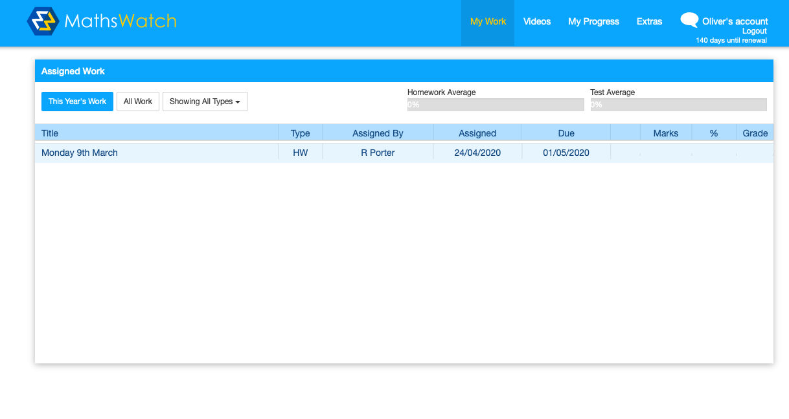

When you have logged in you will see a screen like this. This shows you if you have any assigned work and when it is due.

Slide 4
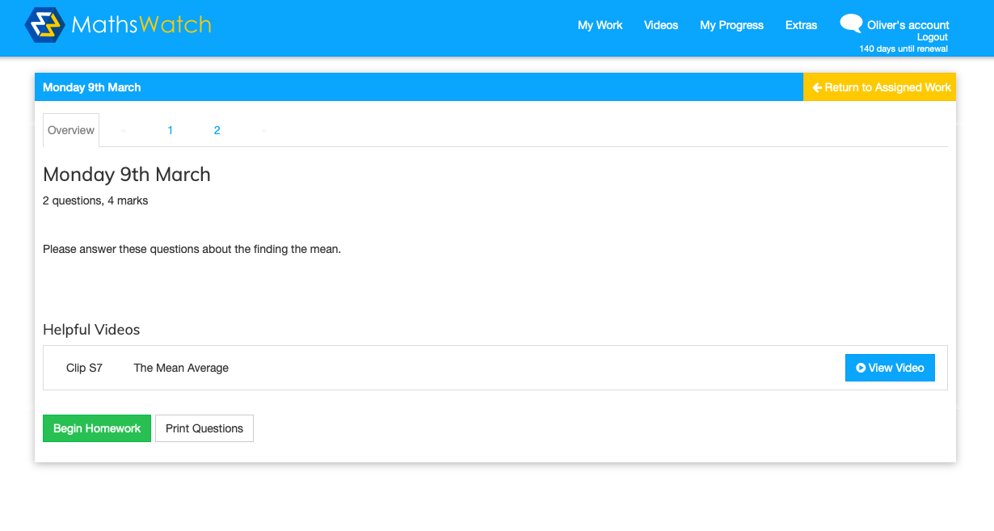
To complete your assigned work, click on it. You will then see a screen like this. You can begin the homework straight away or you can click ‘View Video’, and this will take you to a video explaining how to do similar questions.

Slide 5
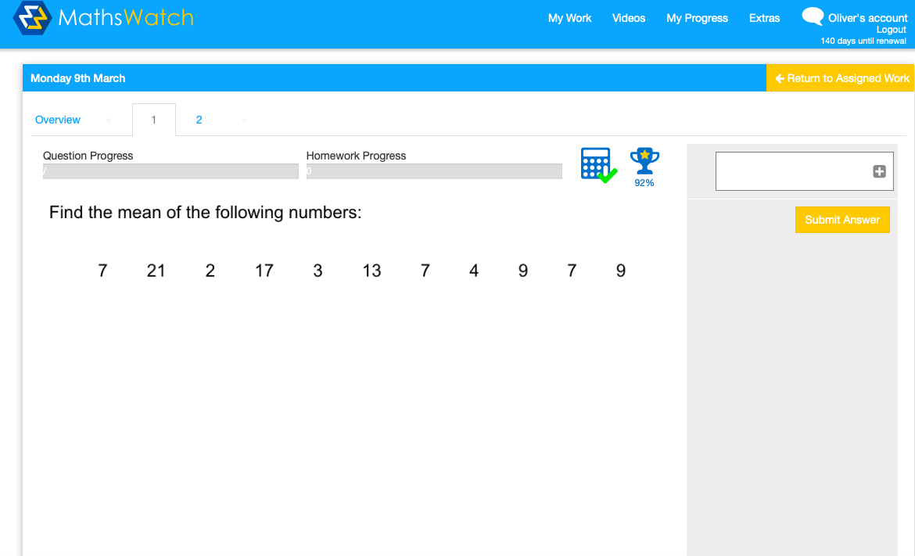
When you begin the task, it will look something like this. Once you have worked out the answer, type it into the text box
and then click ‘Submit Answer’. It will tell you straight away whether you have got it correct or not.
Answer goes here

Slide 6
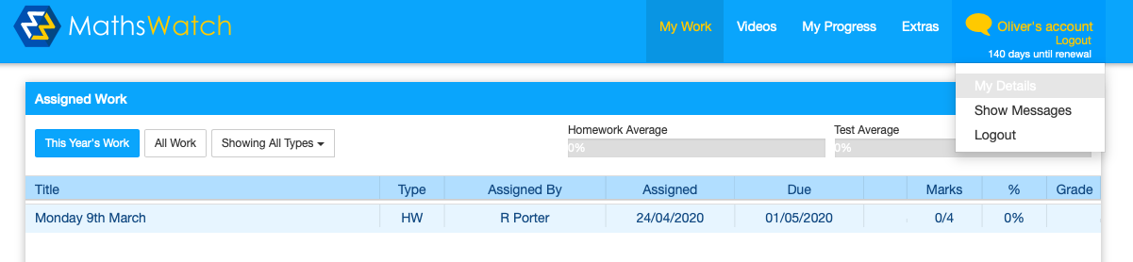
Changing your password (really important!!)
Click on your name in the top right corner, then click on ‘My Details’.

Slide 7
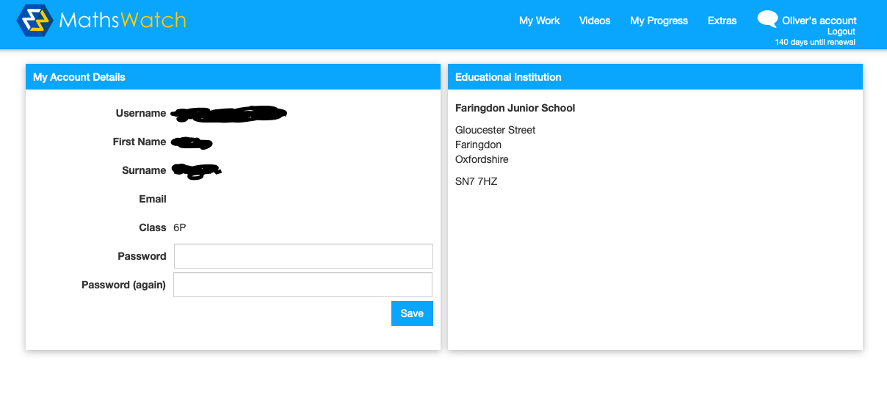
It will then look a bit like this (without the scribbled out information!)
Type in the password you want (make sure it is something you will remember).
Retype it to confirm.
Then click ’Save’.

Slide 8
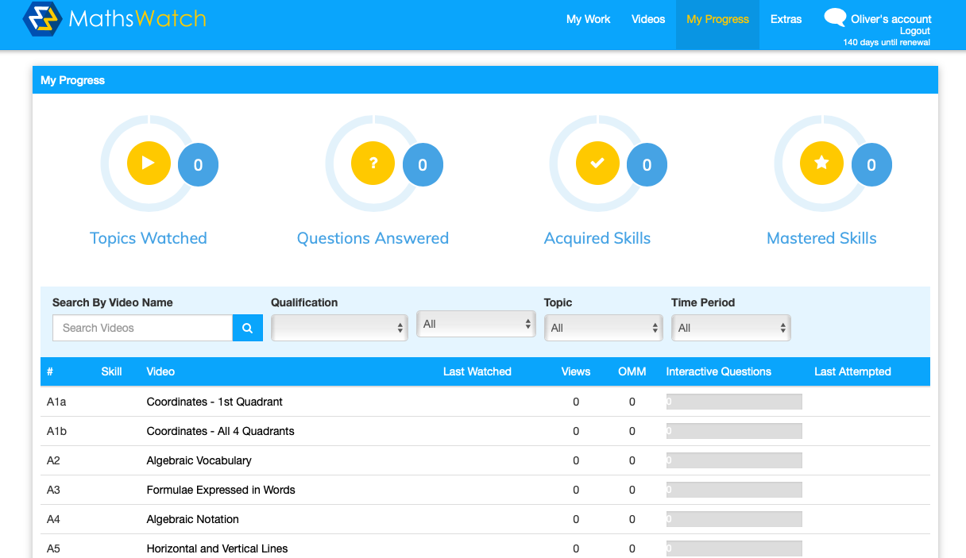
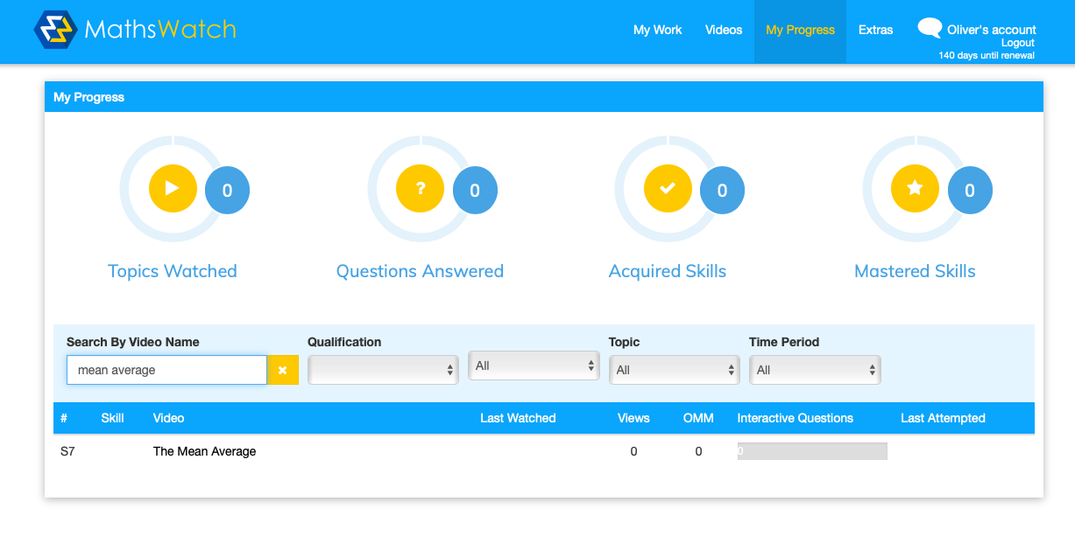
If you have not been assigned any work on Mathswatch but you would like to use a video to help you with something different, you can click on ‘My Progress’ at the top and then search for the video you would like. In this example, I wanted some help with finding the mean average, so I typed it into the search bar and the video appeared. Now I just have to click on the name of the video and it will load.
Type what you are searching for into here

Slide 9
That’s all you need to know for now
Remember we are all learning how to use these new things (including the teachers!) so give it a go, and if you have any questions or feedback please let us know and we will do our best to help!

