Slide 1

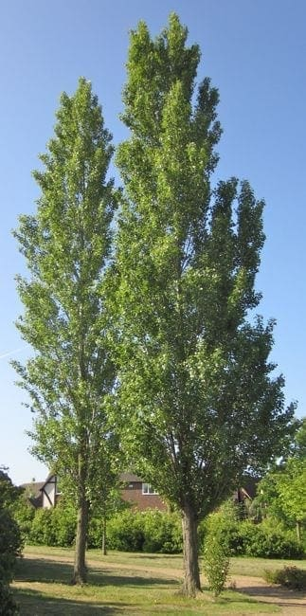

Welcome to Year 5 at The Elms Primary School
Hawthorn and Poplar Classes

Slide 2
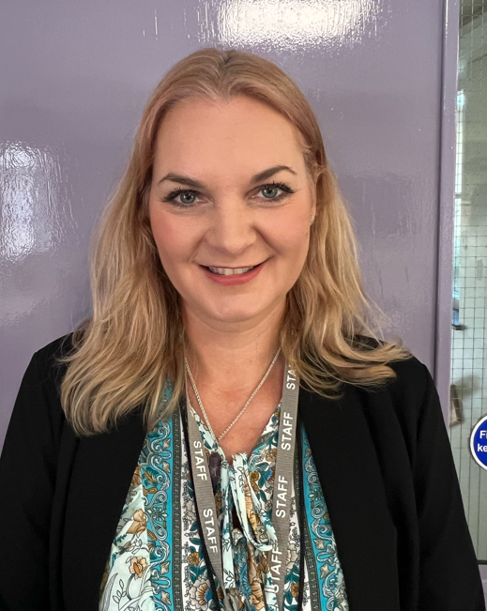
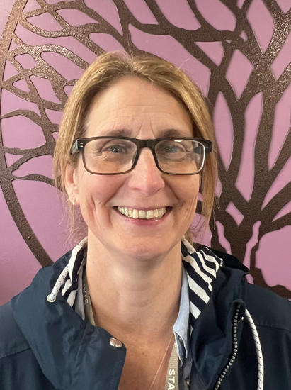
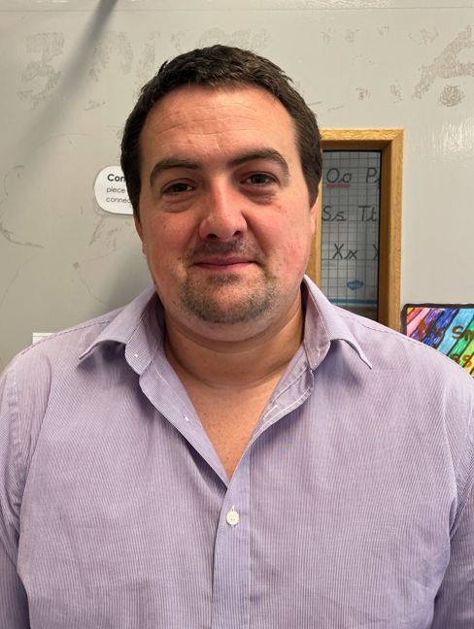
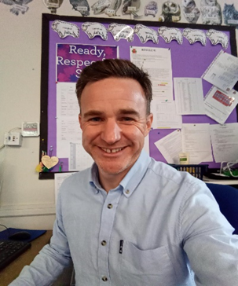
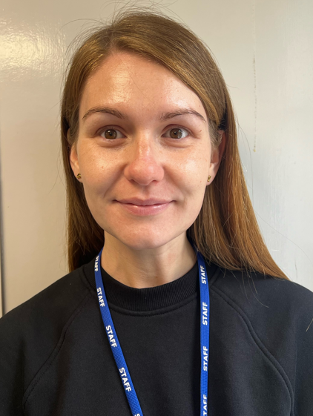
Your Teaching Team
Mr Smith and Mr Moore
Class Teachers
Mrs Castle, Miss Kay, Mrs Taylor and Mrs Robinson
Teaching Assistants

Slide 3
Year X at The Elms
Growth mindset- believing that they can!
Self-regulation- Zones of Regulation
Kindness
What else do you want parents to know about your year groups?

Slide 4
Curriculum Highlights
Trips and visits

Slide 5

Values and Rewards
Values points
Star of the Week
Star of the Term
Mathemagican
Ready, Respectful, Safe Champions
Reader of the Month
Postcards

Slide 6

The School Day
School day starts at 8.40am
Gate closed at 8.55am
Breaktime 11.00-11.15am
Lunchtime 12.15-1.00pm
School day ends 3.10pm.
Attendance- contact the school office by 9am each day of absence

Slide 7
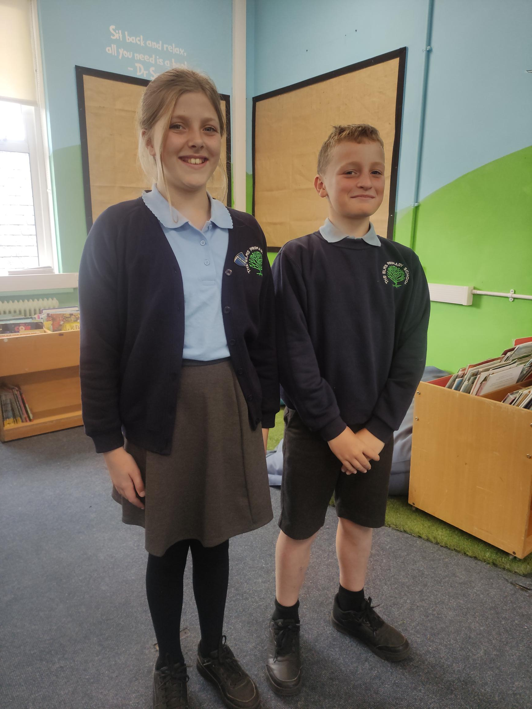
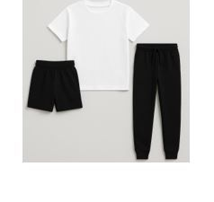
Uniform and Equipment
Reading records
Stationary provided by school
Water bottles and lunch boxes labelled
Coats labelled
Spare uniform can be provided
The Elms Primary Parents Association Preloved Uniform Shop- look on our school website.
Breakfast – long mornings
Healthy snacks- no wrappers

Slide 8
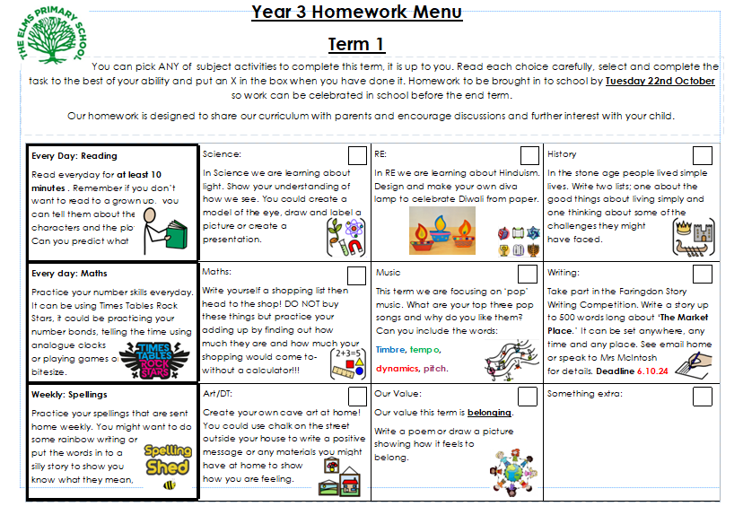

Homework
Menu
Celebrated as a class or shared with peers
Reading daily
Maths practice

Slide 9

How can you help?
Encourage them to read fiction and non-fiction. Don’t forget audio books!
Try to listen to your child read and ask them questions about the text.
TIMES TABLES!!! Practise telling the time. MathsWatch. TTRS

Slide 10

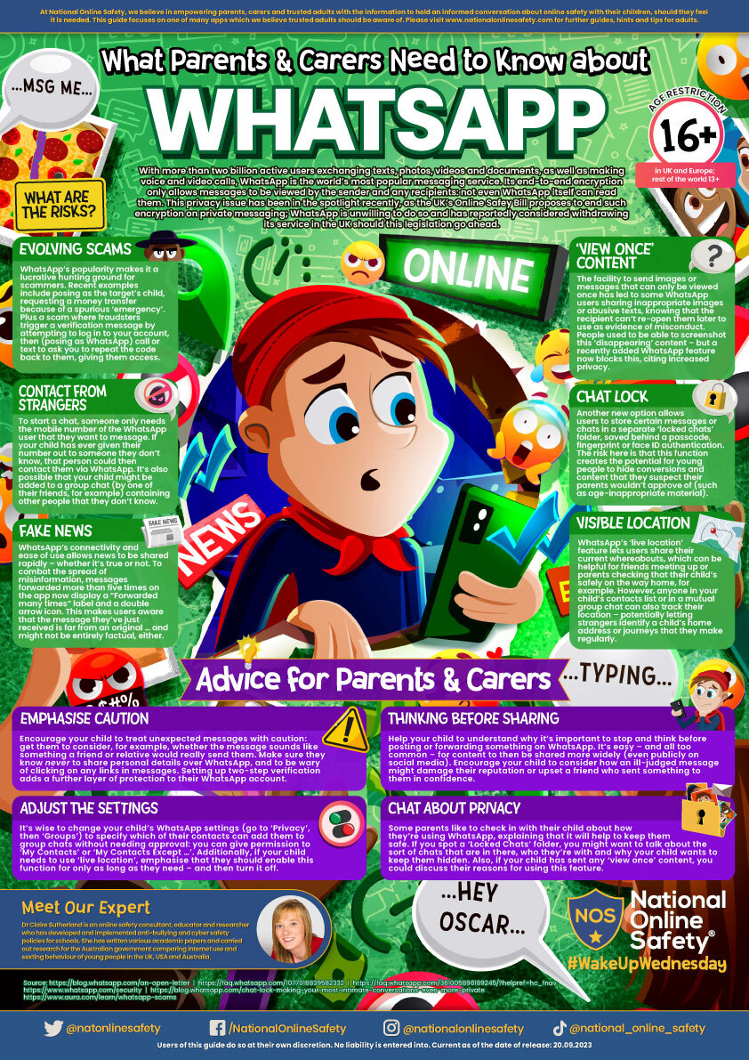
Staying Safe with Technology
The internet is filtered (inappropriate websites blocked).
School Internet Safety Policy is regularly updated
Children at our school:
have regular lessons on E-Safety and how to stay safe online
are trained to tell an adult if they see anything inappropriate
are told never to share passwords
are taught about the danger of sharing personal information online
Please monitor access to internet at home- age limits and checking devices is vital.

Slide 11

Working Together
Parent’s Evening- November 11th and 12th
March 24th and 25th
SEND Meetings
School Reports
Open Afternoons
Class Assemblies
Key dates are shared termly with parents!

Slide 12
Making Contact
office@tep.cambrianlt.org
Please contact the school office in the first instance.
Teachers are available at the end of the school day to arrange further discussions.
Let’s have a great year!

