Slide 1
Parent Meeting
Fred Talk

Slide 2
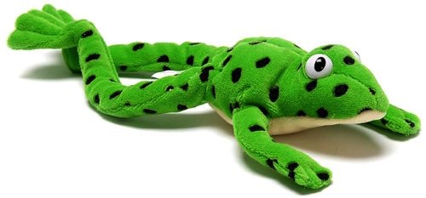
Meet Fred
Fred Frog only talks in sounds, e.g. c – a –t h – a –t .
Fred helps children to learn to blend sounds into a word.
Notes:
Let me introduce you to Fred.
Fred helps children learn to blend sounds into a word.
Fred can only speak in sounds. He says d-o-g, h-a-t etc.
He says the sounds c-a-t, and then children help him to say the word.
This is how we quickly teach all of our children to blend orally.
We practise blending orally so children will find word-reading easier.

Slide 3


Sounds + blending = word reading
+
=
Notes:
When children can read sounds speedily, like this, (show) and understand Fred (m-a-t...mat) (click), they can decode words.

Slide 4
Speed Sounds Set 1
Notes:
Remember that:
children need to know sounds – not letter names – to read words
we say the sounds in a way to make them easy to blend into a word (‘m’ not’ muh’, ’s’ not ‘suh’, etc)
we aim to eliminate the ‘uh’ at the end of the sound. This is called a ‘schwa’ sound.

Slide 5




Reading with Fred Talk
‘Fred Talk’, read the word.
Notes:
Once children know their Set 1 sounds and can orally blend, we teach children to read words using Fred Talk e.g. m-a-t, mat.
We say ‘Fred Talk, read the word’.

Slide 6
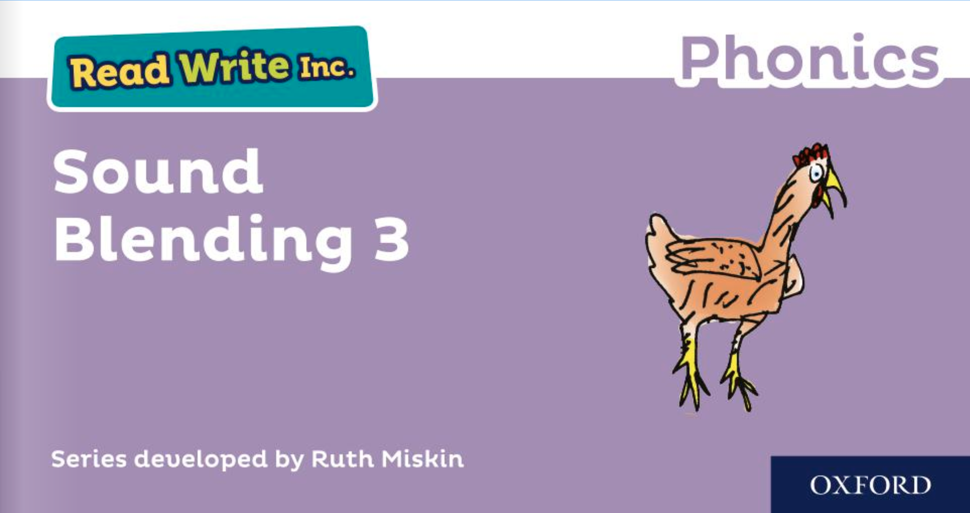
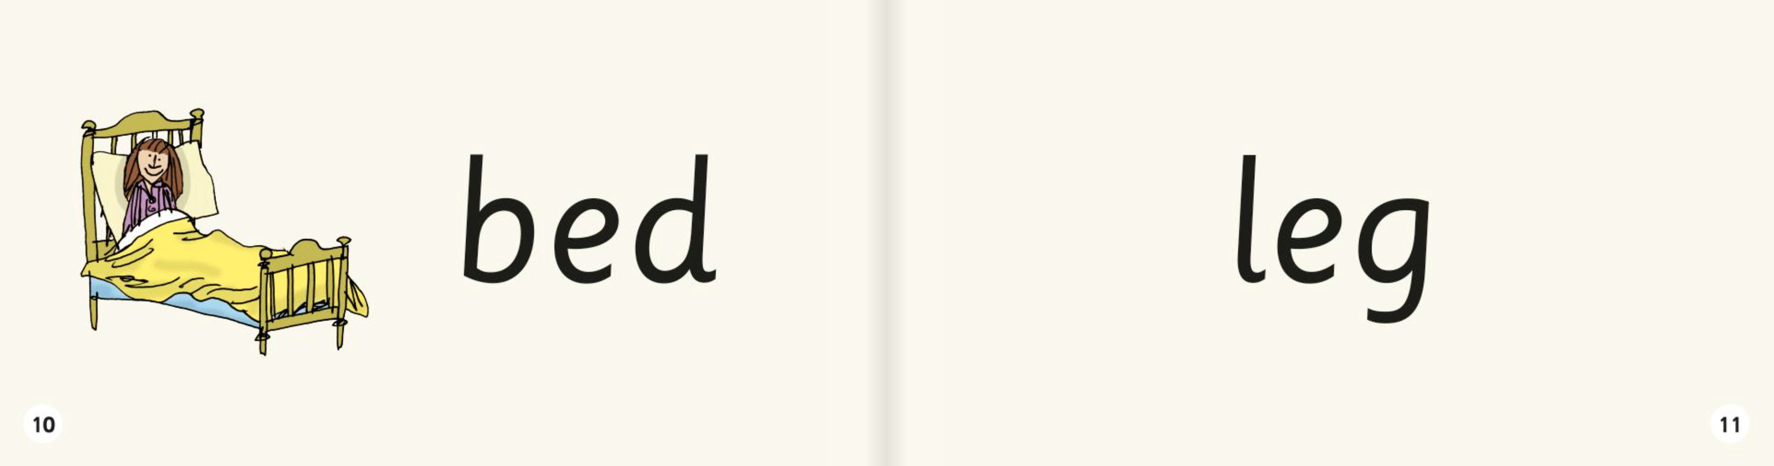
Sound blending books
Once your child can blend the sounds they know to read words, they will bring home a sound blending book.
Notes:
Once your child can blend the sounds they know to read words, they will bring home a sound blending book to practise reading words
Children love reading the word and then using the picture to check if they are right.

Slide 7


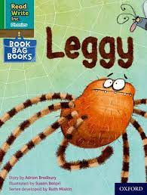
When will my child get a proper reading book?
Assessment every 6 weeks mean your child will be in exactly the appropriate phonics group. ‘Stage not age’.
Notes:
Assessment at the end of every term.
Ch put into different coloured groups so they will be taught exactly where they are in their reading journey.
After sound blending books – dittys – coloured groups where they will take home the book that they have been reading in school and a new book as well as a library book every week.

Slide 8
Reading changes everything
Teach a child to read and keep that child reading and we will change everything.
And I mean everything.
Jeanette Winterson
Notes:
Remember that all parents have the power to change outcomes for their children.

Slide 9

Any questions?

