Slide 1


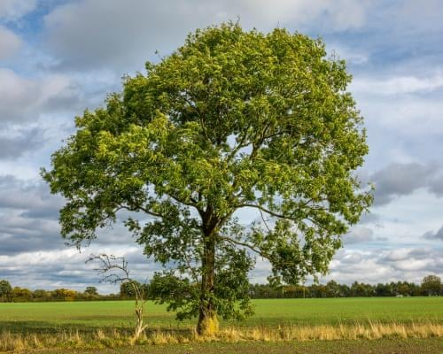
Welcome to Year 1 at The Elms Primary School
Laurel and Ash Class

Slide 2
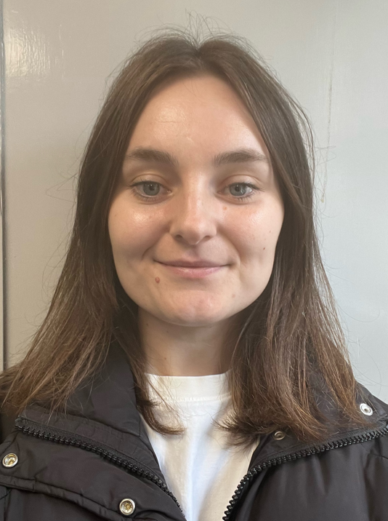
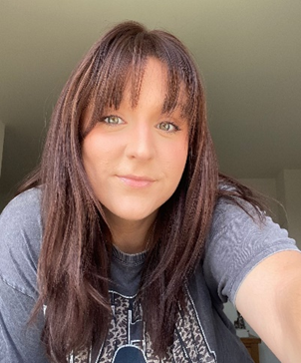
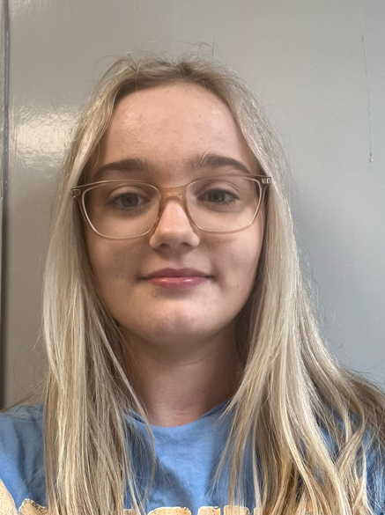
Your Teaching Team
Miss Beszant and Mrs Stewart
Class Teacher
Miss Manton
Teaching Assistant

Slide 3
Year 1 at The Elms
Growth mindset- believing that they can! (power of yet)
Self-regulation- Zones of Regulation
Kindness
Continuous provision throughout the year

Slide 4
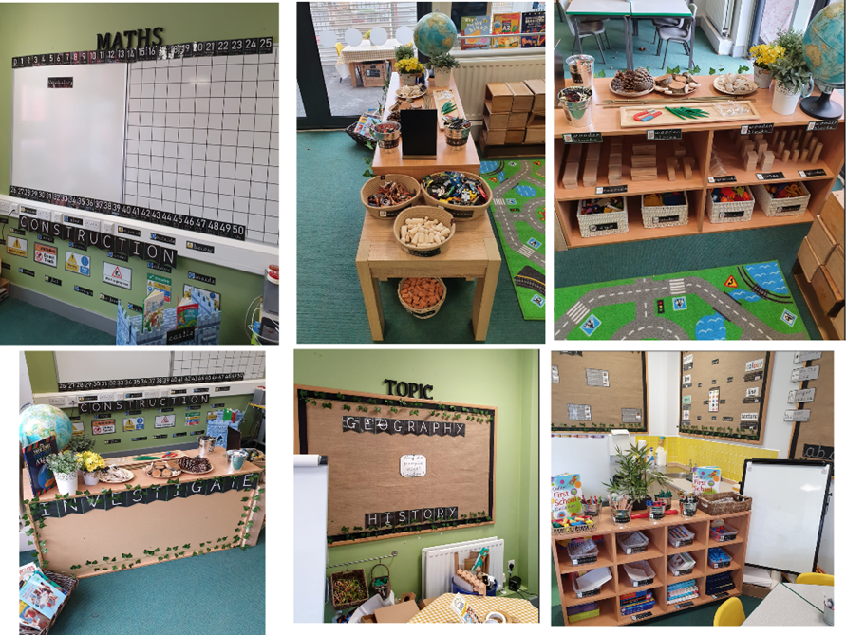
Continuous Provision
The areas:
Inside
Creative corner
Construction
Writing area
Maths area
Small world
Funky fingers
Tuff trays
Zones area
Outside
Water table
Mud kitchen
Construction
Water pump

Slide 5
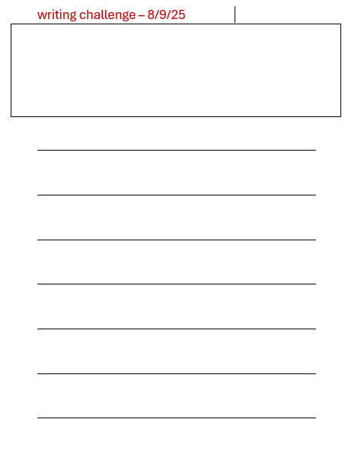

Rainbow Challenges
Children will be given up to 5 challenges a week
Maths
Writing
Phonics
Art
Fine motor

Slide 6
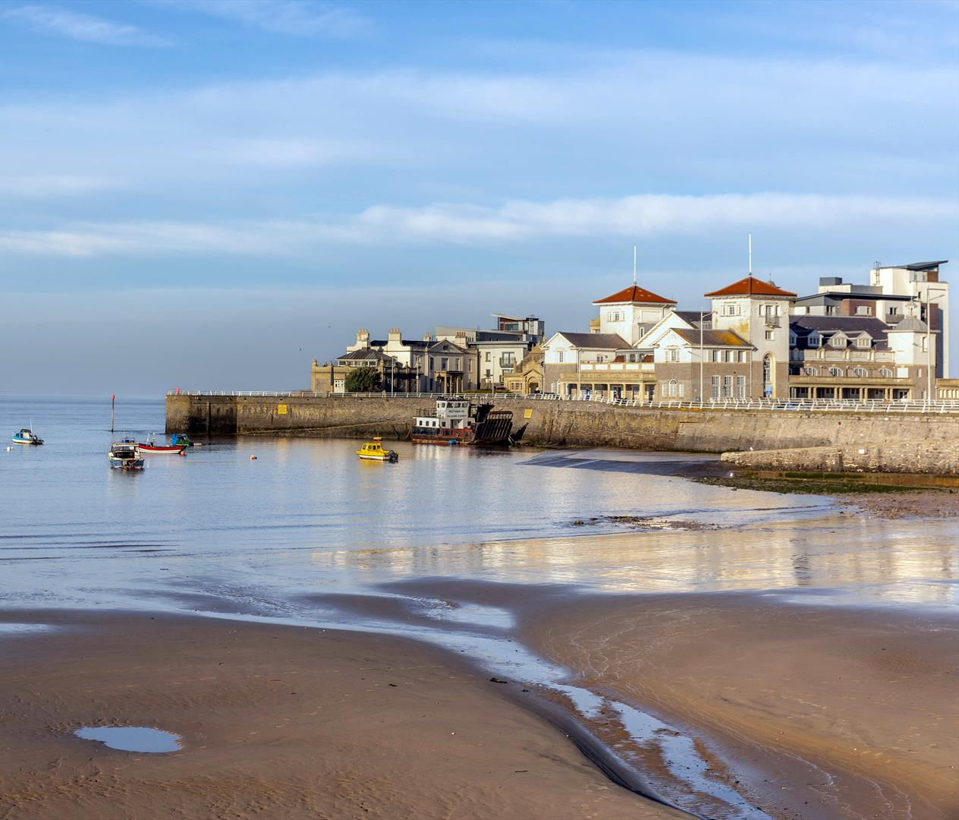

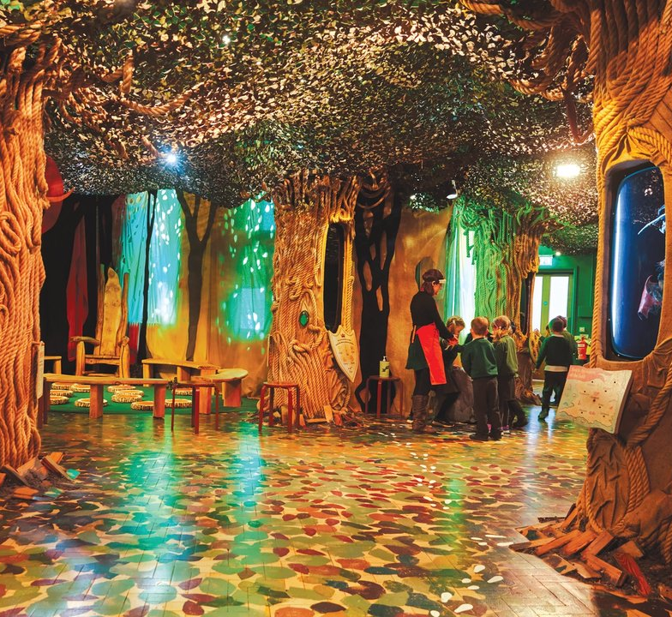
Curriculum Highlights
Story museum
Walks around Faringdon
Posting a letter
Natural history museum
School sleepover
PC Ben
Weston Super Mare

Slide 7

Values and Rewards
Values points
Star of the Week
Star of the Term
Mathemagican
Ready, Respectful, Safe Champions
Reader of the Month
Postcards

Slide 8

The School Day
School day starts at 8.40am - please drop off outside the class room
Gate closed at 8.55am
Lunchtime 12.15-1.00pm
School day ends 3.10pm.
Attendance- contact the school office by 9am each day of absence

Slide 9
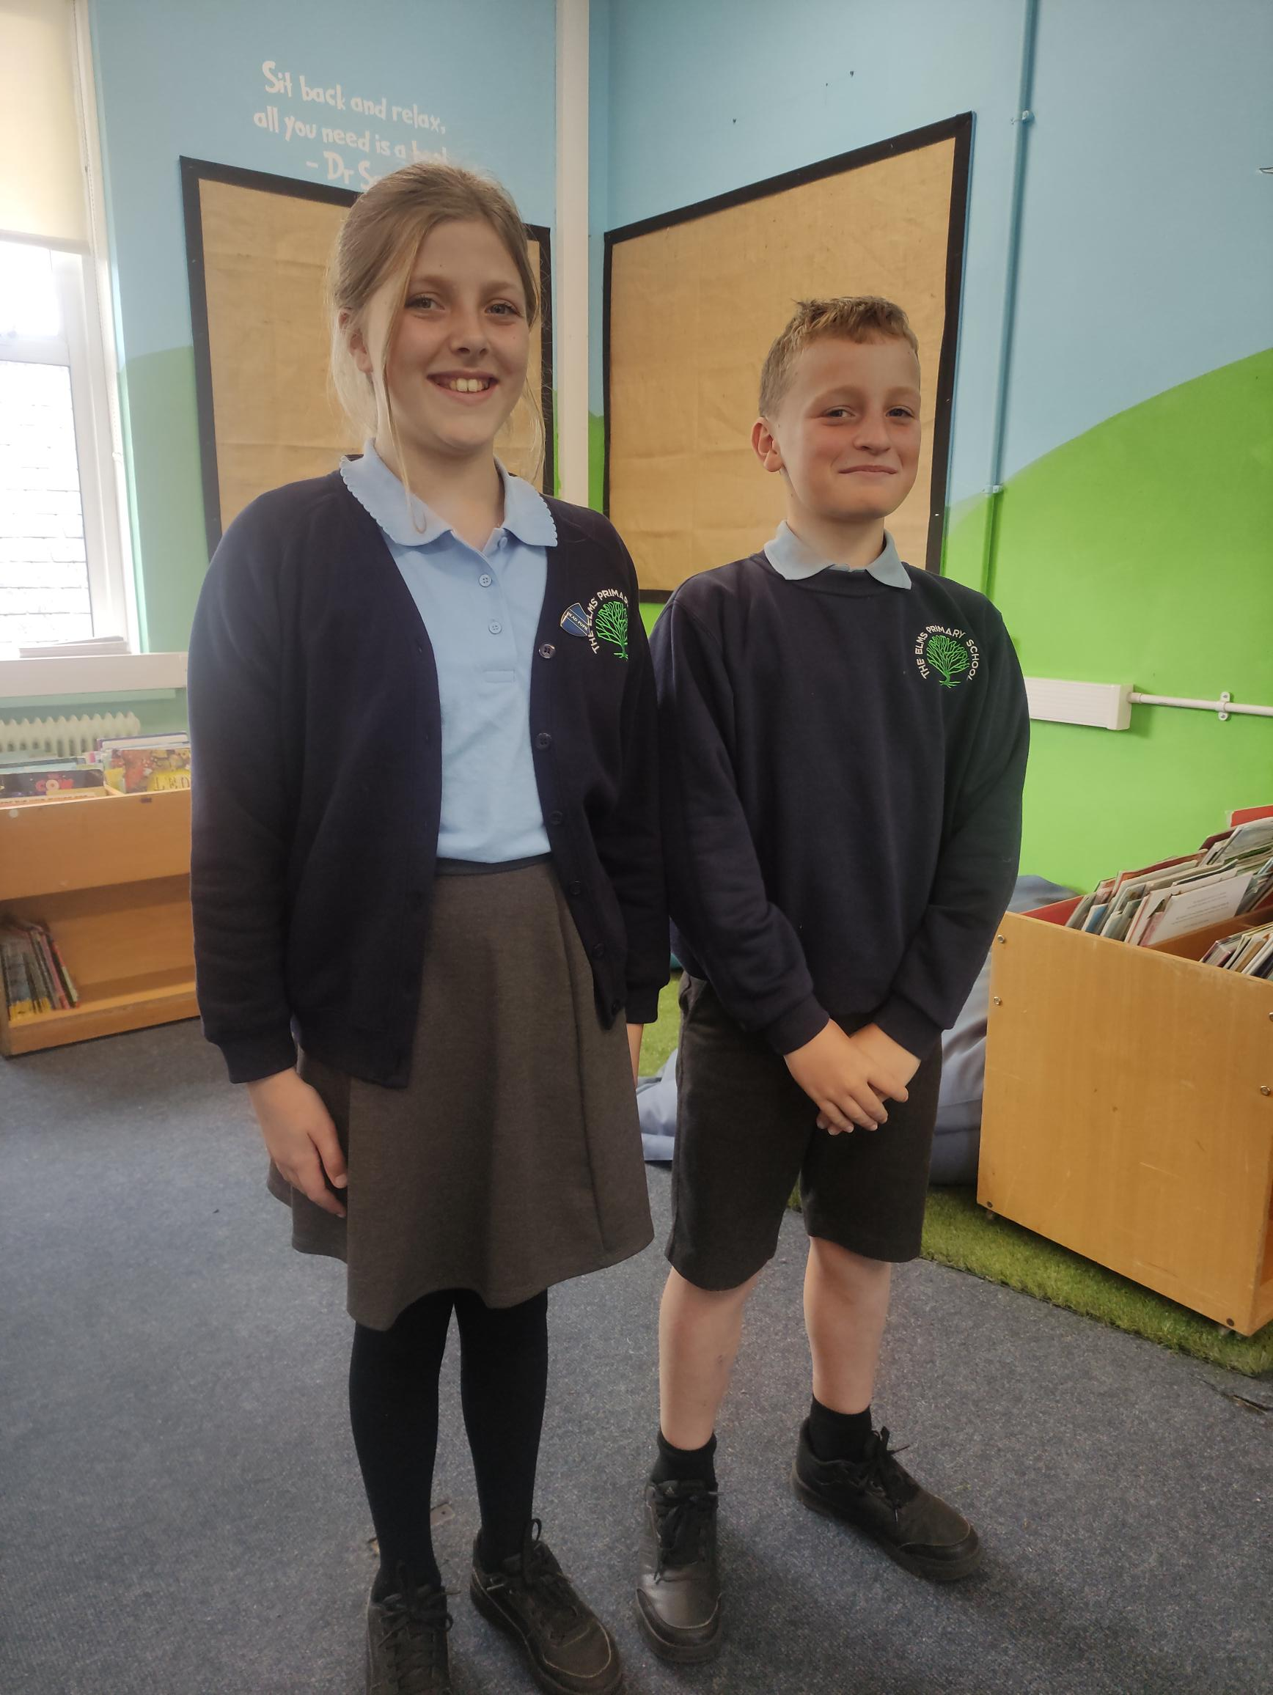
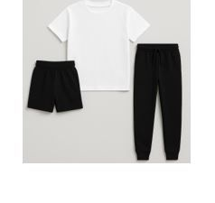
Uniform and Equipment
Stationary provided by school
Water bottles and lunch boxes labelled
Coats labelled
Spare change of clothes and wellies
The Elms Primary Parents Association Preloved Uniform Shop- look on our school website.
Breakfast – long mornings
Healthy snacks- no wrappers

Slide 10
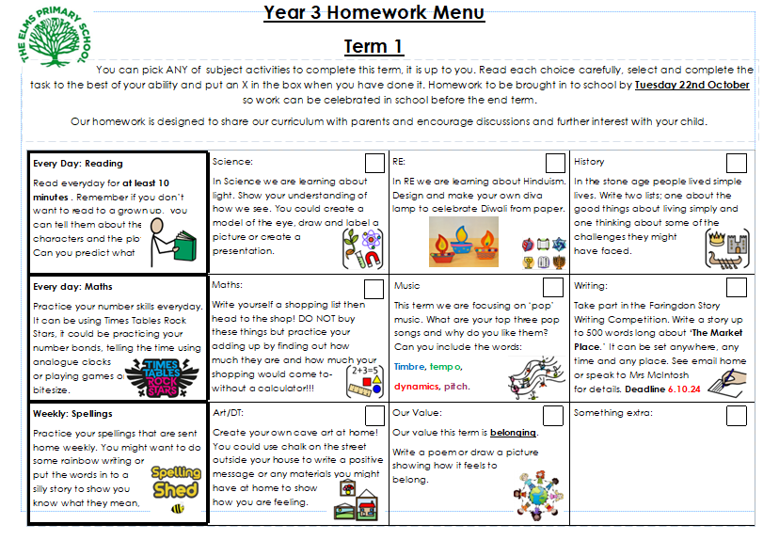

Homework
Menu
Celebrated as a class or shared with peers
Reading daily
Maths practice

Slide 11

How can you help?
Encourage them to read fiction and non-fiction. Don’t forget audio books!
Subtitles on the tv
Try to listen to your child read and ask them questions about the text.
Flash cards with sounds

Slide 12

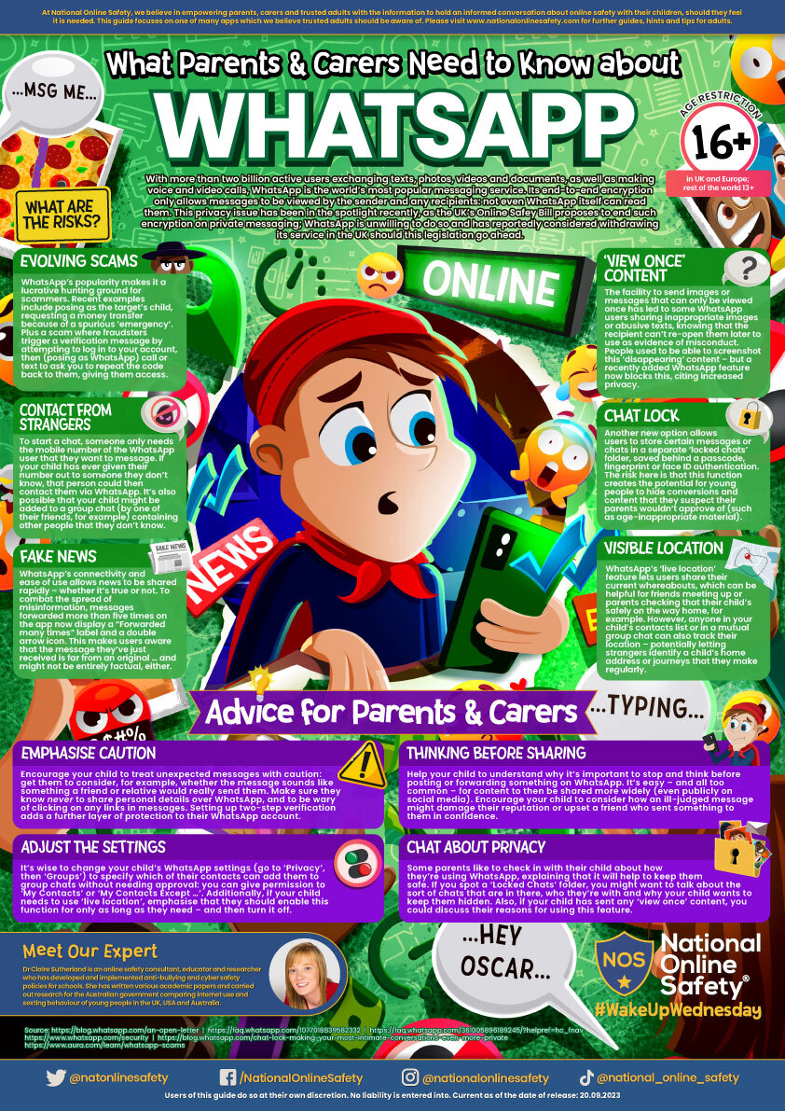
Staying Safe with Technology
The internet is filtered (inappropriate websites blocked).
School Internet Safety Policy is regularly updated
Children at our school:
have regular lessons on E-Safety and how to stay safe online
are trained to tell an adult if they see anything inappropriate
are told never to share passwords
are taught about the danger of sharing personal information online
Please monitor access to internet at home- age limits and checking devices is vital.

Slide 13

Working Together
Parent’s Evening- November 11th and 12th
March 24th and 25th
SEND Meetings
School Reports
Open Afternoons
Class Assemblies
Key dates are shared termly with parents!

Slide 14
Making Contact
office@tep.cambrianlt.org
Please contact the school office in the first instance.
A member of staff will be on the door at the start of the day to take messages and will pass them on to the relevant person.
Teachers are available at the end of the school day to arrange further discussions.
Let’s have a great year!

