Slide 1


Welcome to Year 4 at The Elms Primary School
Willow Class

Slide 2
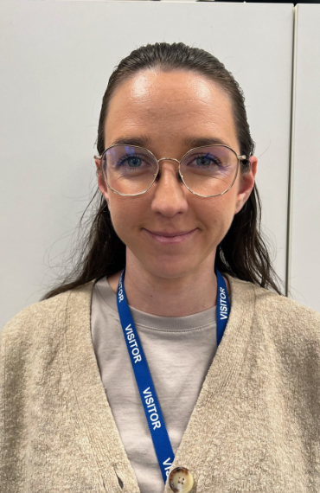
Your Teaching Team
Mrs Grant
Class Teacher
Mrs Robinson
Teaching Assistant

Slide 3
Year 4 at The Elms
Growth mindset – believing that they can!
Self-regulation – Zones of regulation
Kindness
Swimming – 10 weeks: Tuesday starting 16th September – 25th November
MTC test – multiplication test in June

Slide 4
Curriculum Highlights
Trips and visits:
  We planning to run two trips this year, but are still being confirmed. All details will be sent out soon.
We have plenty in house experiences for your children too – Faringdon Twinning Association come to visit at the end of the year, author visits (in person and online), Finance Fridays, dance workshops etc. ​

Slide 5

Values and Rewards
Values points
Star of the Week
Star of the Term
Mathemagican
Ready, Respectful, Safe Champions
Reader of the Month
Postcards

Slide 6

The School Day
School day starts at 8.40am
Gate closed at 8.55am
Breaktime 11.00-11.15am
Lunchtime 12.15-1.00pm
School day ends 3.10pm.
Attendance – contact the school office by 9am each day of absence.

Slide 7
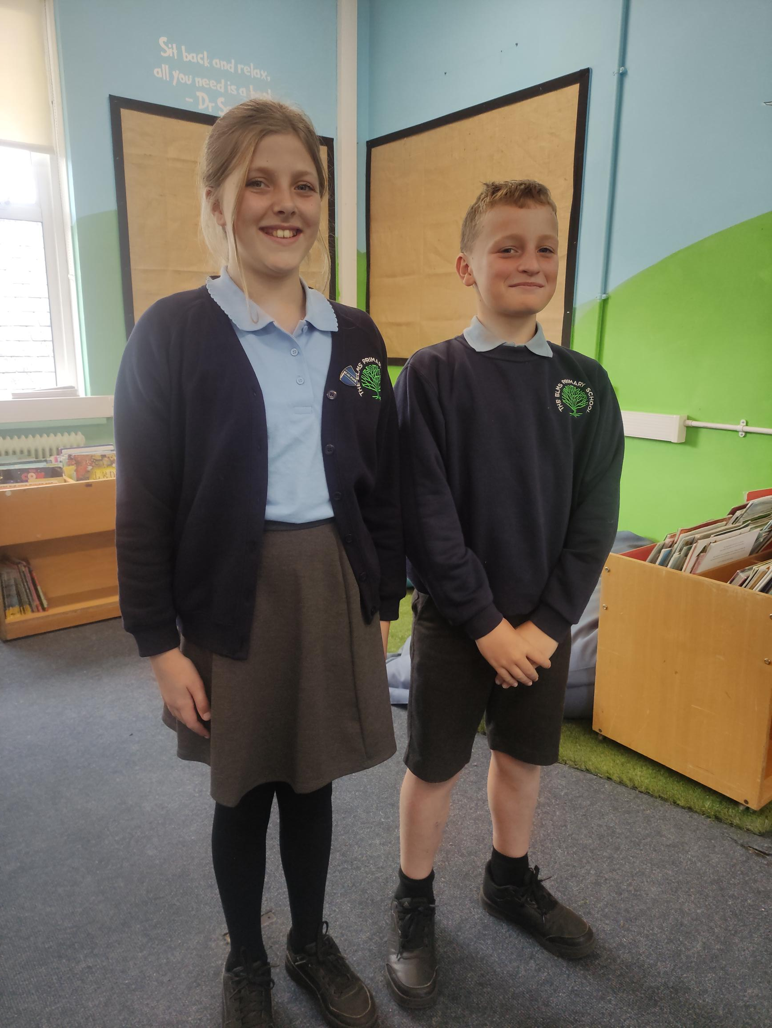
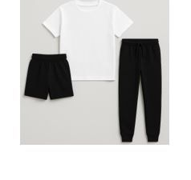
Uniform and Equipment
Reading records
Stationary provided by school
Water bottles and lunch boxes labelled
Coats labelled
Spare uniform can be provided
The Elms Primary Parents Association Preloved Uniform Shop – look on our website!
Breakfast – long mornings
Healthy snacks – no wrappers and NO NUTS

Slide 8
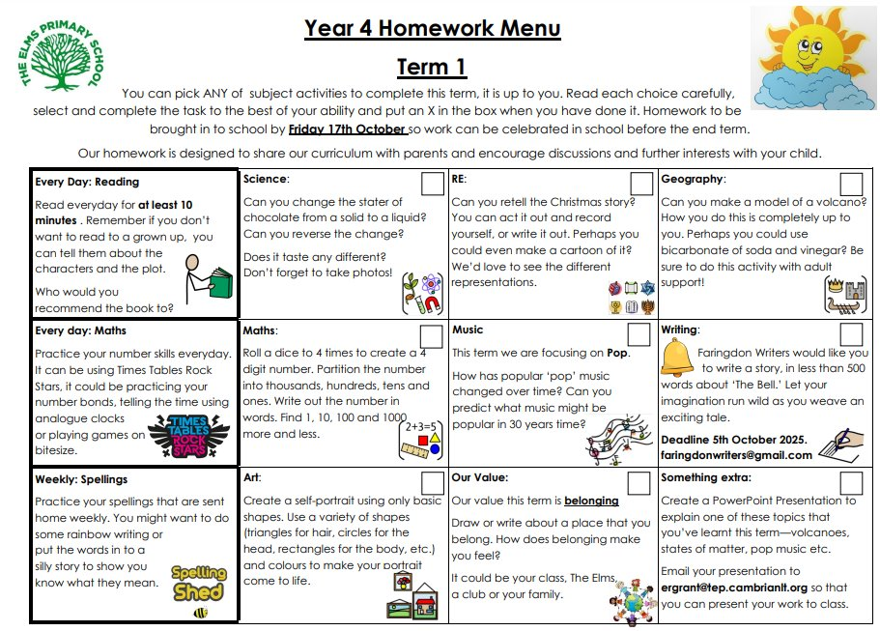

Homework
Menu
Celebrated as a class or shared with peers
Reading daily
Maths practice

Slide 9

How can you help?
Encourage them to read fiction and non-fiction. Don’t forget audio books!
Try to listen to your child read and ask them questions about the text.
TIMES TABLES!!! Practise telling the time. MathsWatch. TTRS

Slide 10

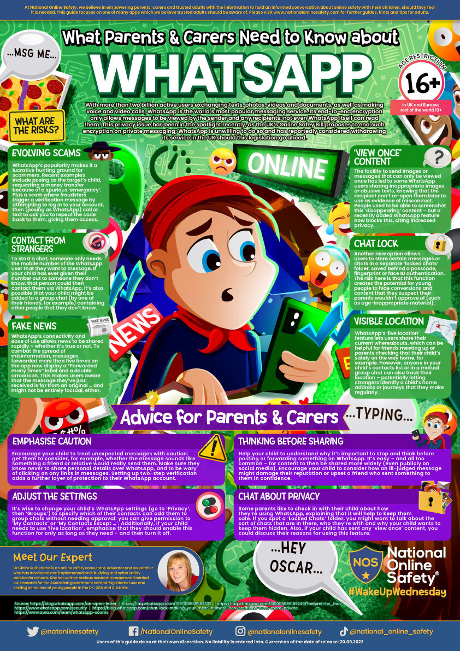
Staying Safe with Technology
The internet is filtered (inappropriate websites blocked).
School Internet Safety Policy is regularly updated
Children at our school:
have regular lessons on E-Safety and how to stay safe online
are trained to tell an adult if they see anything inappropriate
are told never to share passwords
are taught about the danger of sharing personal information online
Please monitor access to internet at home- age limits and checking devices is vital.

Slide 11

Working Together
Parent’s Evening – 11th and 12th November
– 24th and 25th March
SEND Meetings
School Reports
Open Afternoon – 2nd December
Class Assemblies – 3rd December
Key dates are shared termly with parents!

Slide 12
Making Contact
office@tep.cambrianlt.org
Please contact the school office in the first instance.
Teachers are available at the end of the school day to arrange further discussions.
Let’s have a great year!

